Slide 1

Sip-Client to Java
Souradeep Bera
Mentor : Lovekesh Garg
Manager : Tejasv Gupta
© 2022 Sprinklr, Inc. CONFIDENTIAL - INTERNAL ONLY. All rights reserved.

Slide 2
Agenda
1
Objective
4
Incorporation with Existing Flow
2
Theory - SIP & RTP
5
Challenges Faced & Future Works
3
Understanding the Code
6
Learnings
© 2022 Sprinklr, Inc. CONFIDENTIAL - INTERNAL ONLY. All rights reserved.

Slide 3
Objective
© 2022 Sprinklr, Inc. CONFIDENTIAL - INTERNAL ONLY. All rights reserved.

Slide 4
Objective
What?
Shift the sip-client, currently implemented in TypeScript to Java.
Build an end-to-end Agent in Java which will sit between Ozonetel and VoiceBot to facilitate the signalling and media transfer between the two.
Why?
TypeScript is single threaded and hence does not scale well.
With large clients coming into the picture, scalability is an important issue which had to be addressed. This can be achieved by shifting the code in Java and leveraging its multi-threaded nature
© 2022 Sprinklr, Inc. CONFIDENTIAL - INTERNAL ONLY. All rights reserved.

Slide 5
Session Initiation Protocol (SIP)
© 2022 Sprinklr, Inc. CONFIDENTIAL - INTERNAL ONLY. All rights reserved.

Slide 6
Session Initiation Protocol (SIP)
What is it?
The Session Initiation Protocol (SIP) (RFC 3261) is an application-layer control protocol that can establish, modify and terminate multimedia sessions or calls.
It is a text-based protocol and uses the UTF-8 charset (RFC 2279)
Supports five facets of establishing and terminating multimedia communications:
User location
User availability
User capabilities
Session setup
Session management
© 2022 Sprinklr, Inc. CONFIDENTIAL - INTERNAL ONLY. All rights reserved.

Slide 7
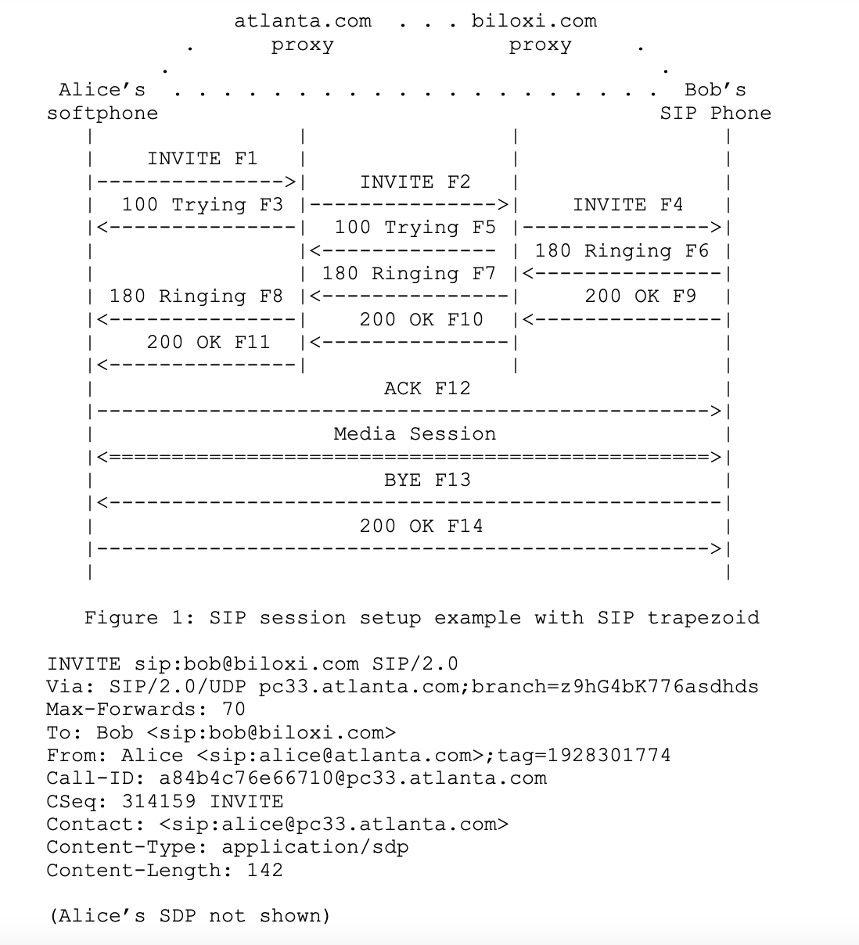
Session Initiation Protocol (SIP)
INVITE Request
SIP is based on an HTTP-like request/response transaction model. Each transaction consists of a request that invokes a particular method, or function, on the server and at least one response.
The details of the session are not described using SIP. Rather, the body of a SIP message contains a description of the session, encoded in some other protocol format like SDP (RFC 2327).
The INVITE/200/ACK three-way handshake used to establish SIP sessions
© 2022 Sprinklr, Inc. CONFIDENTIAL - INTERNAL ONLY. All rights reserved.

Slide 8
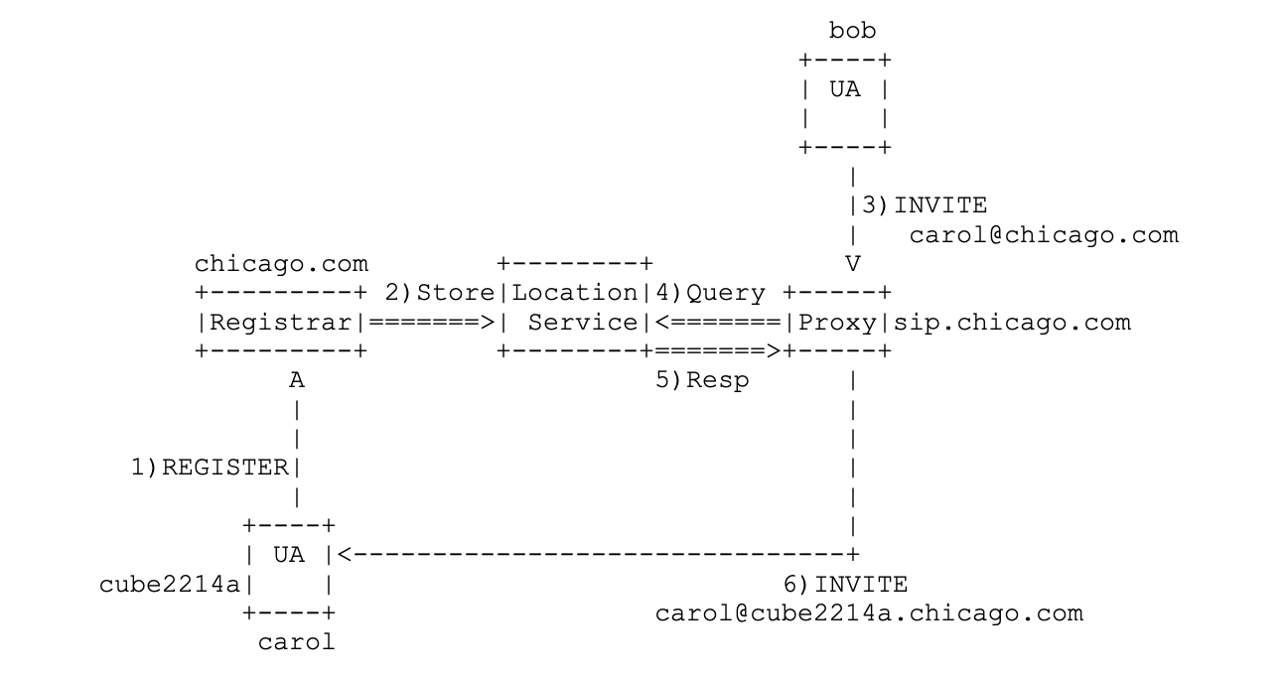
Session Initiation Protocol (SIP)
REGISTER Request
Sent to the registrar server, expires after specified amount of time
© 2022 Sprinklr, Inc. CONFIDENTIAL - INTERNAL ONLY. All rights reserved.

Slide 9
Real Time Transport Protocol (RTP)
© 2022 Sprinklr, Inc. CONFIDENTIAL - INTERNAL ONLY. All rights reserved.

Slide 10
Real Time Transport Protocol (RTP)
What is it?
RTP provides end-to-end delivery services for data with real-time characteristics, such as interactive audio and video.
Services include payload type identification, sequence numbering, timestamping and delivery monitoring.
Typically RTP is run on top of UDP
© 2022 Sprinklr, Inc. CONFIDENTIAL - INTERNAL ONLY. All rights reserved.

Slide 11
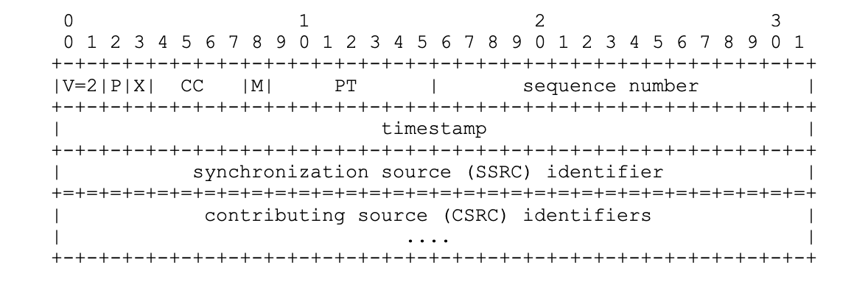
Real Time Transport Protocol (RTP)
RTP Packet
A data packet consisting of the fixed RTP header, a possibly empty list of contributing sources (see below), and the payload data.
The data transported by RTP in a packet is referred to as payload data
© 2022 Sprinklr, Inc. CONFIDENTIAL - INTERNAL ONLY. All rights reserved.

Slide 12
Understanding the Code
© 2022 Sprinklr, Inc. CONFIDENTIAL - INTERNAL ONLY. All rights reserved.

Slide 13
Understanding the Code
Overall Flow
Sprinklr’s agent registers with the registrar server to make Ozonetel aware about the agent
End user calls helpline number of Sprinklr’s customer
Ozonetel initiates signaling with Agent
Media codecs, RTP ports and other information regarding media transfer are exchanged via SIP and SDP
RTP session is set-up directly between Ozonetel and Agent and media is exchanged. Hang up when done
© 2022 Sprinklr, Inc. CONFIDENTIAL - INTERNAL ONLY. All rights reserved.

Slide 14
Understanding the Code
Component Breakdown
Ozonetel
SIP + SDP
Signalling via SIP Protocol and set up call. Exchange information via SDP.
Ozonetel
Ozonetel sends data via RTP
RTP Receiver
RTP Sender
Agent sends back processed data via RTP
Sends data received from Ozonetel to Bot via websocket
Websocket
Bot
Returns processed data to send back to Ozonetel via websocket
© 2022 Sprinklr, Inc. CONFIDENTIAL - INTERNAL ONLY. All rights reserved.

Slide 15
Understanding the Code
Agent Breakdown
Agent
Signalling
Media Transfer
Session Initiation Protocol (SIP)
Session Description Protocol (SDP)
Realtime Transport Protocol (RTP)
Websocket
© 2022 Sprinklr, Inc. CONFIDENTIAL - INTERNAL ONLY. All rights reserved.

Slide 16
Understanding the Code
Code Flow
RTP Receiver
Incoming Data
Inbound Queue
Websocket
RTP Sender
Outbound Queue
Outgoing Data
© 2022 Sprinklr, Inc. CONFIDENTIAL - INTERNAL ONLY. All rights reserved.

Slide 17
Incorporation with Existing Flow
© 2022 Sprinklr, Inc. CONFIDENTIAL - INTERNAL ONLY. All rights reserved.

Slide 18
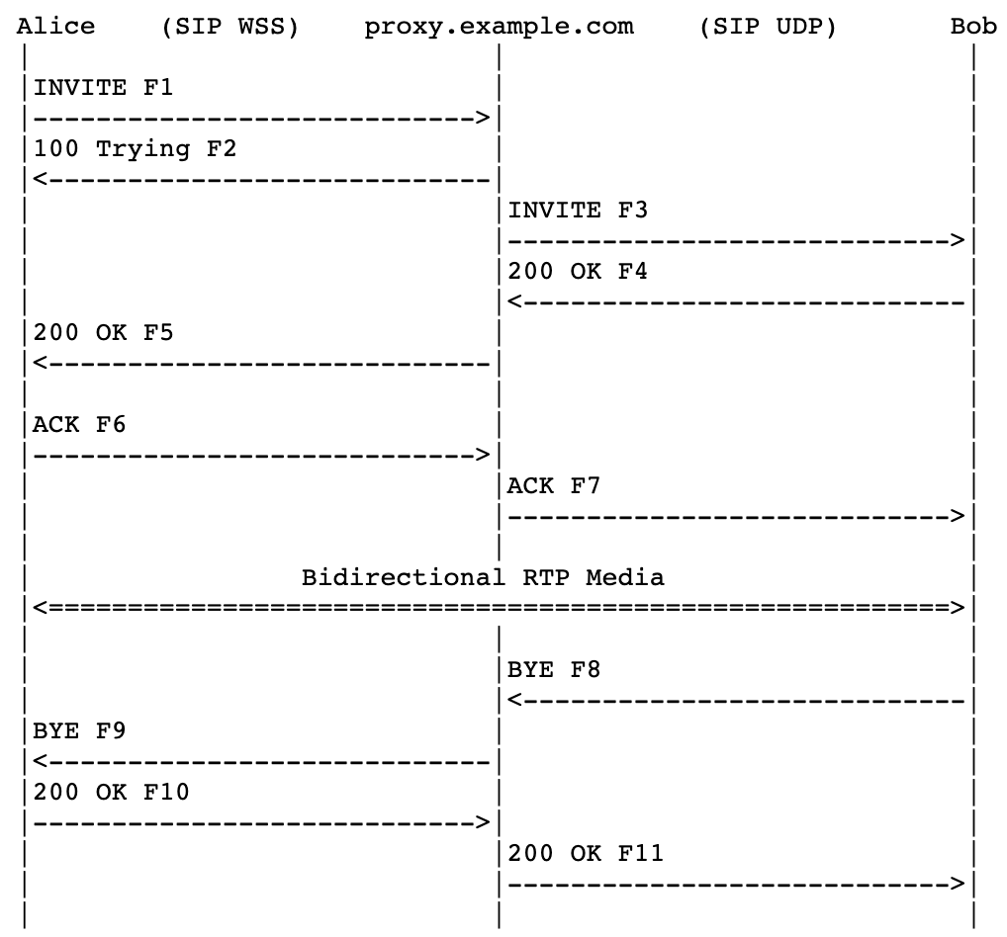
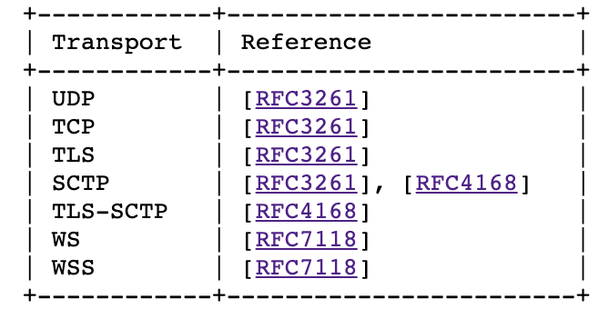
Incorporation with Existing Flow
Currently, JsSIP is used which implements RFC 7118
It just adds a new subregistry, "SIP Transport", to the "Session Initiation Protocol (SIP) Parameters" registry.
Just switch transport modes from ws/wss to udp
© 2022 Sprinklr, Inc. CONFIDENTIAL - INTERNAL ONLY. All rights reserved.

Slide 19
Challenges Faced
© 2022 Sprinklr, Inc. CONFIDENTIAL - INTERNAL ONLY. All rights reserved.

Slide 20



Challenges Faced
Lack of Documentation
Overcome by referring to the reference implementation by adding dependency for the same
Lack of examples
Very few code examples available. The majority of the examples were dealing with android applications. Solved by keeping logs and comparing with RFCs
Tough to test if code runs properly
Solved by creating our own mock clients for the signaling and media transfer entities
© 2022 Sprinklr, Inc. CONFIDENTIAL - INTERNAL ONLY. All rights reserved.

Slide 21
Future Works
© 2022 Sprinklr, Inc. CONFIDENTIAL - INTERNAL ONLY. All rights reserved.

Slide 22
Future Works
Add onto RTP functionality
Incorporate RTCP packets
Move from RTP to SRTP
Make additions to signalling and media transfer entities. e.g. support SIP over Websockets, currently SIP over UDP/TCP/TLS is supported. Or add functionality for media transfer through WebRTC, currently RTP is supported.
© 2022 Sprinklr, Inc. CONFIDENTIAL - INTERNAL ONLY. All rights reserved.

Slide 23
Learnings
© 2022 Sprinklr, Inc. CONFIDENTIAL - INTERNAL ONLY. All rights reserved.
© 2022 Sprinklr, Inc. CONFIDENTIAL - INTERNAL ONLY. All rights reserved.

Slide 24
My Learnings
Technical Skills
Hands-on learning about the best practices in Java, from naming conventions and scope definitions to memory management and threading
Exposure to multiple databases including Redis, MongoDB and ElasticSearch. Understanding the underlying concepts and identifying their pros and cons
Introduction to Kafka for streaming. Firsthand practice by implementing a mini-project to extract tweets from Twitter and store them in ElasticSearch using Kafka
Understanding the importance of benchmarking and the importance of optimising even in the smallest of places. Might turn out to be a huge money-saver for the company
Acquired an in-depth understanding of the SIP protocol and RTP protocols which were the building blocks of the project
© 2022 Sprinklr, Inc. All rights reserved.
© 2022 Sprinklr, Inc. CONFIDENTIAL - INTERNAL ONLY. All rights reserved.

Slide 25

My Learnings
Non-Technical Skills
Appreciating how a company adapts when it has to deal with large amounts of data - resolving scalability issues
Building a framework which can be easily understood and extended since the end-goal is to not just get your individual project running, but incorporating it seamlessly into the existing codebase
Delivering good quality code and debugging in minimal time in high pressure environments
Passionately, genuinely care

Slide 26

People don’t care how much you know
unless they know how much you care
© 2022 Sprinklr, Inc. CONFIDENTIAL - INTERNAL ONLY. All rights reserved.

Slide 27
Thank you
souradeep.bera@sprinklr.com
sprinklr.com

